Slide 1

HMI as a Leading Indicator for REIT Liquidity

Slide 2
Presentation Overview
01
Motivation & Literature
02
Research Design
03
Data
04
Methodology
05
Results
06
Interpretations & Limitations
07
Conclusions & Future Research

Slide 3

Motivation
Why Real Estate Investment Trusts?
Regulatory Constraints (26 U.S.C. §857): REITs must distribute 90% of taxable income, preventing internal capital accumulation.
High dependency on public equity/debt markets for growth.
REITs retain minimal earnings for tackling financing disruptions
Unlike typical firms, REITs must perpetually access public debt and equity markets to fund operations
Highsensitivity to external liquidity "dry-ups."

Slide 4
Literature Review
Market Liquidity Spirals
Sentiment & Performance
Brunnermeier and Pedersen (2009)
Hadad, Le, and Luong (2024)
When market illiquidity arises, this can trigger a feedback loop of liquidity spiraling, where funding and market liquidity reinforce each other's decline.
REITs transmit and receive shocks driven by shocks in sentiment.
Study limited to equity performance rather than broader liquidity metrics.
Property Market Links
Macroeconomic Variables
Downs and Zhu (2022)
Glascock and Lu-Andrews (2014)
Liquidity in REITs impacted by local real estate markets.
Study limited to property market liquidity specifically.
REIT liquidity affected by macroeconomic variables.
Study limited to inflation and interest rates as primary drivers.

Slide 5



Research Question. Comparative Research Framework
Residential Group
Non-Residential Group
Focused on housing assets (ESS, UDR, MAA, CPT). Theoretically directly linked to HMI sentiment.
Infrastructure & Logistics assets (AMT, EQIX, PLD). Serves as a baseline for macro-systemic shocks.
"Is the HMI signal a housing-specific channel or a broad macro-proxy?"

Slide 6
Data Sources
Financial & Market Data
CRSP (WRDS)
Daily returns, prices, share volume
Computed Amihud illiquidity ratio
Compustat (WRDS)
Annual Firm Fundamentals
Total Assets & Total Liabilities
Macro & Sentiment Indicators
NAHB HMI: Home builders sentiment index
10-yr Treasury Yield: Risk-free rate (FRED)
VIX Index: Market fear gauge (YFinance)
Sample Period
Aug 2000 — Dec 2024
N = 1,752 firm-month observations
Asset Universe
Residential REITs
ESS, UDR, MAA, CPT
Non-Residential REITs
AMT, EQIX, PLD

Slide 7
Data Transformations
Firm time varying controls
Size Control
Natural logarithm of Total Assets
Captures firm-specific scale effects on liquidity depth.
Leverage Control
Ratio: Total Liabilities / Total Assets
Proxies for financial distress and balance sheet constraints.
Asset Growth
YoY % Change in Total Assets
Controls for firm expansion and investment cycles.
Amihud Illiquidity Ratio
ILLIQi,t = 1/Di,t Σ |Ri,d,t| / DVoli,d,t
Amihud (2002) proposes a measure of illiquidity, which is the daily ratio of absolute stock return to its dollar volume. This can be interpreted as “the daily price response associated with one dollar of trading volume, thus serving as a rough measure of price impact.”
Note: For days without a closing price, a bid/ask average was used. To align with monthly sentiment indices, we aggregated daily data into a monthly panel: returns were compounded, volumes summed, and illiquidity ratios were averaged and log-transformed for the analysis.

Slide 8
Econometric Specifications. Part I
Model 1: Sector-Specific Interaction
Model 2: Aggregate Market Model
log(ILLIQi,t) = β₀ + β₁(HMIt-1 × Resi) + β₂HMIt-1 + β₃Resi + β₄log(ILLIQi,t-1) + ΓXi,t + δMacrot + εi,t
log(ILLIQi,t) = α₀ + α₁(HMIt-1) + α₂log(ILLIQi,t-1) + ΓXi,t + δMacrot + εi,t
Hypothesis (H1): Housing sentiment is a unique leading indicator for residential REITs (β₁ ≠ 0) because their underlying assets tie directly to physical housing.
β₁: Captures the differential impact on the residential group.
Controls: AR(1) persistence, Firm-level (Size, Lev, Growth), and Macro (VIX, 10Y Yield).
Hypothesis (H2): HMI acts as a broad leading indicator for the entire REIT sector (α₁ ≠ 0), reflecting systemic capital shifts.
α₁: Captures the systemic impact of housing sentiment across all property types.
Simplification: Interaction and dummy terms are dropped to estimate the overall market effect.
Statistical Robustness & Inference
Clustered Standard Errors: We group errors at the ticker level to account for arbitrary correlation within firms over time (serial correlation) and heteroskedasticity.
Granger Causality: A split-sample check (residential vs. non-residential) confirms that the HMI signal contains unique predictive information, ensuring it is not a proxy for general market liquidity.
Note: Pooled OLS framework with Clustered Standard Errors. Control variables (Size, Leverage, Asset Growth) recorded annually.

Slide 9

Econometric Specifications. Part II
Impulse Response Function (IRF) & Dynamics
Simulation Method
Persistence & Decay
Recovery Speed Measure
Deterministic simulation of a 1 S.D. positive shock to HMI at t=1.
Traces propagation over a 12-month horizon using split-sample OLS coefficients.
Initial impact decays geometrically via the estimated autoregressive coefficient (α̂AR(1)) for each sector.
Half-Life = -ln(2) / ln(α̂AR(1))
Number of months for the initial liquidity shock to revert to 50% of its original magnitude.

Slide 10

Results. Model 1: Sector-Specific Interaction
Key Interpretation
-0.0010
We fail to reject the null hypothesis regarding sector-specific sensitivity.
INTERACTION COEFFICIENT
p = 0.675 (Insignificant)
HMI does not differentially predict liquidity dry-ups in residential vs non-residential REITs. The signal appears systemic.

Slide 11
Results. Model 2: Aggregate Market Success
Variable | Coefficient | P-Value | Interpretation
Lagged HMI (30-day) | 0.0031 | < 0.01 *** | Robust Leading Indicator
Lagged Illiquidity | 0.7773 | < 0.01 *** | High persistence (Stickiness)
Firm Size (Log Assets) | -0.2157 | < 0.01 *** | Scale improves market depth
HMI serves as a critical 30-day early warning system for the broader REIT sector.

Slide 12
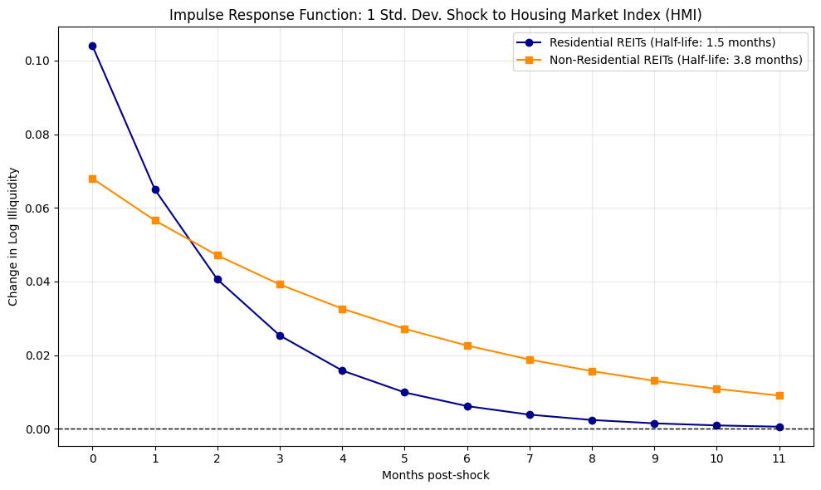

Results. Impulse Response: Structural Recovery Gaps
"So What?"
While the signal is systemic, the recovery speed is asset-specific.
Non-Residential (3.8 mo half-life)
Liquidity is "stickier"—dry-ups linger significantly longer into the fiscal year.

Slide 13

Residential Dynamics
Assets directly tied to physical housing turnover. High fluidity allows for rapid 1.5-month recovery from liquidity shocks.
HMI peaks signal capital rotation out of public equities into direct development.

Slide 14

Institutional Stickiness
Non-residential sectors (Data Centers/Logistics) face a 3.8-month digestion period. Their institutional nature causes liquidity to remain constrained for longer.
Investors must account for duration of droughts, not just magnitude.

Slide 15

Conclusions
01
02
03
Null Hypothesis
Secondary Conclusions
Impulse Response
Fail to reject Null Hypothesis regarding sector-specific sensitivity
HMI does not differentially predict liquidity “dry-ups” between residential and broader REITs
HMI serves as a powerful macro-indicator for the broader real estate equity market
Critical 30-day early warning system for tracking liquidity shifts
Structural difference in recovery times from housing market shocks
Investors must account for magnitude AND duration of liquidity constraints

Slide 16
Limitations and Future Study
Limitations
Future Study
Broader firm sample
Isolation of HMI during extreme market stress
Longer lag structure
Selection bias
Omitted variable bias
Residual endogeneity
Framework cannot control for unobserved firm-level heterogeneity

